Slide 1
Differences between Computer Architecture and Computer Organization
Computer Architecture is a functional description of the design implementation and requirements of different components of a computer, while Computer Organization provides information about the linking of different operational attributes of the computer system.
What is Computer Architecture?
Computer Architecture is a blueprint for design and implementation of a computer system. It refers to the overall design of a computer system, including the hardware and software components that make up the system and how they interact with each other.
Computer architecture provides the functional details and behavior of a computer system. It involves the design of the instruction set, the microarchitecture, and the memory hierarchy, as well as the design of the hardware and software components that make up the system.
Computer Architecture mainly deals with the functional behavior of a computer system and covers the "What to do?" part. It gives the functional description of requirements, design, and implementation of the different parts of a computer system.
In the designing process of a computer system, the computer architecture is to be defined before the computer organization.

Slide 2
What is Computer Organization?
Computer Organization refers to the way in which the hardware components of a computer system are arranged and interconnected. It implements the provided computer architecture and covers the "How to do?" part.
Computer Organization is to be defined after the decision of the computer architecture. It just provides information that how operational attributes of a computer system are linked together and help in realizing the architectural specification of the computer. It involves the design of the interconnections between the various hardware components, as well as the design of the memory and I/O systems.

Slide 3
Differences between Computer Architecture and Computer Organization
The following table highlights how Computer Architecture is different from Computer Organization −
Key | Computer Architecture | Computer Organization
Purpose | Computer architecture explains what a computer should do. | Computer organization explains how a computer works.
Target | Computer architecture provides functional behavior of computer system. | Computer organization provides structural relationships between parts of computer system.
Design | Computer architecture deals with high level design. | Computer organization deals with low level design.
Role | Computer architecture assists in understanding the functionality of the computer. | Computer organization helps to understand the exact arrangement of component of a computer.
Actors | Actors in Computer architecture are hardware parts. | Actor in computer organization is performance.
Order | Computer architecture is designed first. | Computer organization is started after finalizing computer architecture.
Involves | Computer architecture involves the relationship among logical attributes of the system like instruction sets, data types, addressing modes, etc. | Computer organization involves the relationship among physical parts of the system like circuits, peripherals, etc.

Slide 4
Conclusion
In general, Computer Architecture is concerned with the overall design of a computer system, while Computer Organization is concerned with the way in which the hardware components of the system are arranged and interconnected.
The most important point that you should note here is that Computer Architecture explains what a computer should do, whereas Computer Organization explains how a computer works.
Memory Organization
The memory unit is essential component in any digital computer since it is needed for storing program and data at the beginning, at the end to store result and for intermediate storage during execution.
Two fundamental objective for memory design are
1. Higher Speed
2. More space or size at reasonable cost
Concept for speed enhancement
1. Memory Interleaving
2. Cache Memory
Concept for size enhancement
1. Virtual memory
2. Shared memory

Slide 5
Interleaved Memory :
Any given memory module has a fixed memory bandwidth i.e. the number of bytes transferred per second. The CPU is capable of handling much higher bandwidth than the memory. Due to mismatch between memory bandwidth and CPU speed, the CPU has to go idle frequently for the need of instruction or data from the memory.
Memory interleaving is a technique of reorganizing the main memory into multiple independent modules, so that multiple modules can be accessed overlapping, so that the overall bandwidth is increased multiple times.
The following diagrams will make the concept clear
Figure 1: Linear addressing scheme
Figure 2: 4 way interleaving scheme
Figure 3: 2 x 2 way interleaving scheme

Slide 6
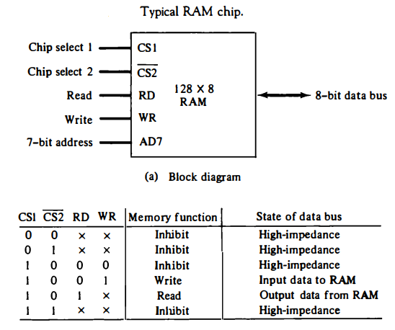

Slide 7
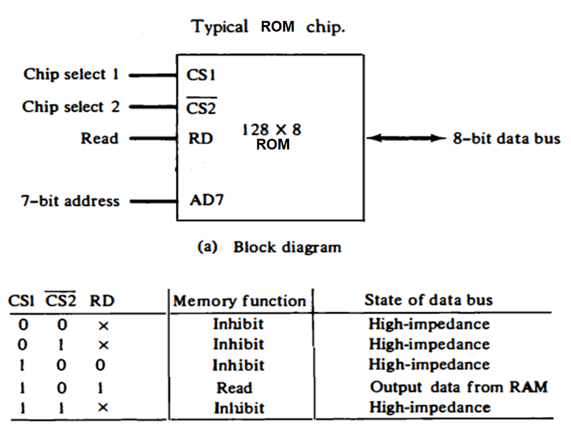

Slide 8
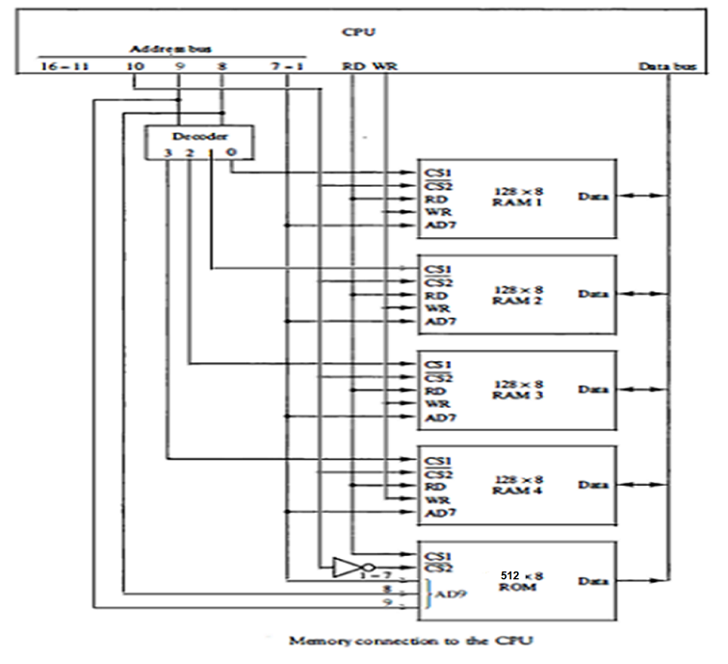

Slide 11
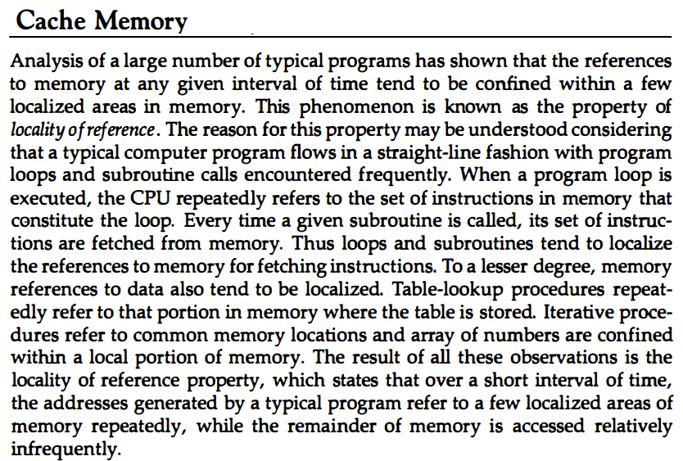

Slide 12
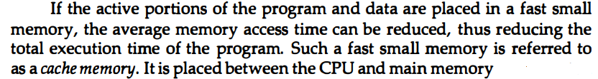
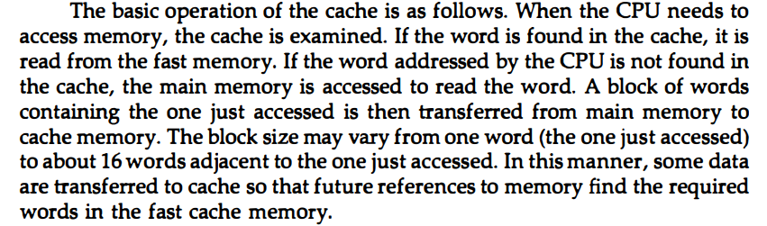
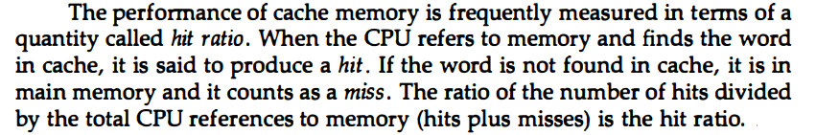
Cache Memory Continued

Slide 13
Cache Memory
Analysis of a large number of typical programs has shown that the references to memory at any given interval of time tend to be confined within a few localized areas in memory.
This phenomenon is known as the property of Locality of Reference.
1. Temporal locality of reference
2. Spatial locality of reference
Temporal Locality
The current instruction which is being fetched may be needed again soon.
Spatial Locality
The adjacent instructions to current instruction may be needed soon.
In view of these two properties, while accessing the main memory for any instruction, instead of fetching just one instruction from main memory, several consecutive instructions are fetched together and stored in cache memory.
Cache read policy: Read through policy
Read back policy
Cache write policy: Write through policy
Write back policy

Slide 14
Read Through: If the addressed location is not in cache, the content of the addressed location is forwarded to the cache as well as sent to the CPU for execution and remaining consecutive locations are copied to cache along with the execution by CPU.
Read Back: The entire block containing the addressed location is transferred from main memory to cache and then the addressed location is forwarded to CPU for execution.
Write Through: If the content of the addressed location needs to be changed during execution, the cache location is changed with the new value as well as the corresponding main memory location is also updated accordingly.
Write Back: If the content of the addressed location needs to be changed during execution, the cache content is updated only and marked for the change. Finally at the termination or for replacement need the entire cache page is copied back to corresponding main memory block. The logic behind is that in many cases the same addressed location is repeatedly updated during the stay in cache, we need the last change to be updated in main memory.

Slide 15
The basic characteristic of cache memory is its fast access time. Therefore, very little or no time must be wasted when searching for words in the cache. The transformation of data from main memory to cache memory is referred to as a mapping process.
Three types of mapping procedures are of practical interest when considering the organization of cache memory:
1. Direct mapping
2. Associative mapping
3. Set-associative mapping

Slide 16
To elaborate on cache organization we must discuss to fundamental issues namely
Mapping techniques
Page replacement techniques
The basic characteristic of cache memory is its fast access time. Therefore, very little or no time must be wasted when searching for words in the cache. The transformation of data from main memory to cache memory is referred to as a mapping process.
Three types of mapping procedures are of practical interest when considering the organization of cache memory:
1. Direct mapping
2. Associative mapping
3. Set-associative mapping
There are various replacement algorithms namely
FIFO, First in First out
LRU, Least recently used
NUR, Not used recently
Optimal replacement algorithm etc.

Slide 17
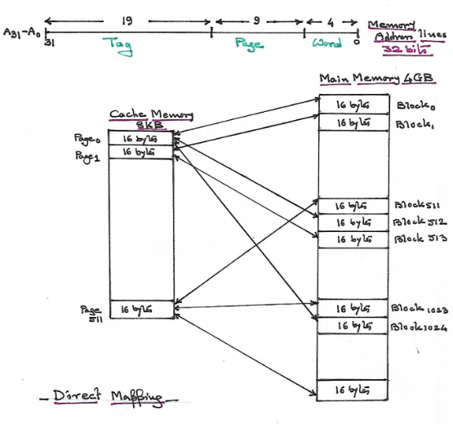

Slide 18
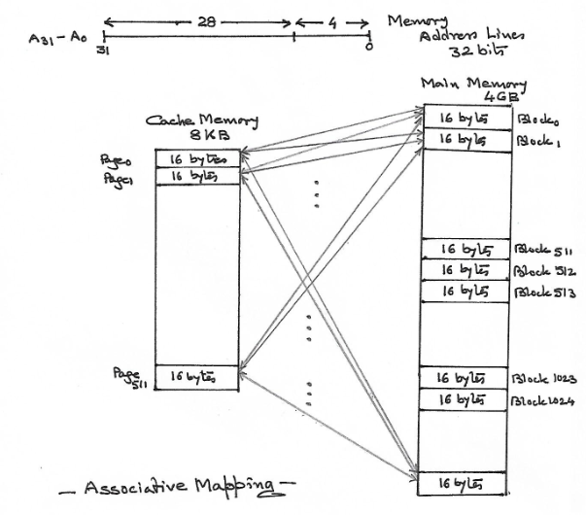

Slide 19
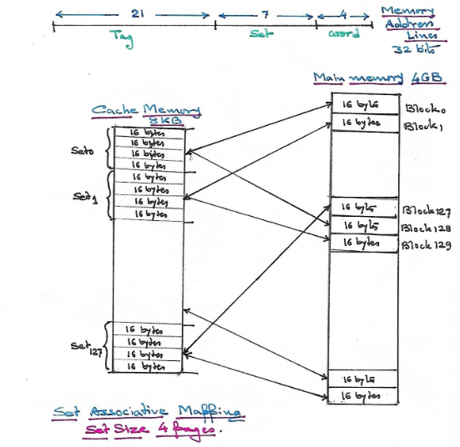

Slide 20
Associative Memory or Content Addressable Memory The time required to find an item stored in memory can be reduced considerably if stored data can be identified for access by the content of the data itself rather than by an address ( normal memory organisation where address is generated by the CPU and the data comes out of the memory). A memory unit which is accessed by content is called Content Addressable Memory (CAM) or Associative Memory (as it finds an use in associative mapping in cache memory environment). This type of memory is accessed simultaneously and in parallel on the basis of data content rather than by specific address or location. Because of its organisation, the associative memory is uniquely suited to do parallel searches by data association. Moreover, searches can be done on an entire word or on a specific field within a word (parallel match). Associative memory is more expensive than random access memory because each cell has storage capability as well as match logic circuitry. For this reason associative memories are used in applications where the search time is very critical and must be very short.

Slide 21
A 101 111100
K 111 000000
Word 1 100 111100 no match 0
Word 2 101 000001 match 1
Word 3 001 111100 no match 0
Match Register Content will be 010

Slide 22
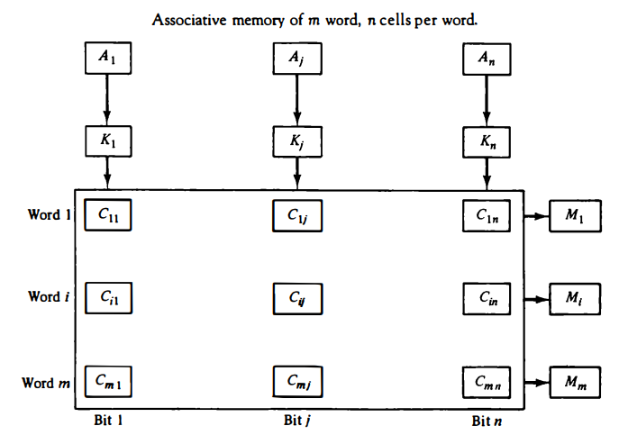
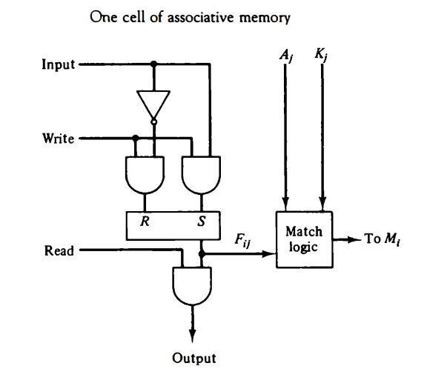
The internal organization of a typical cell Cij
Relation between the memory array and external registers in an
Associative Memory Organization

Slide 23
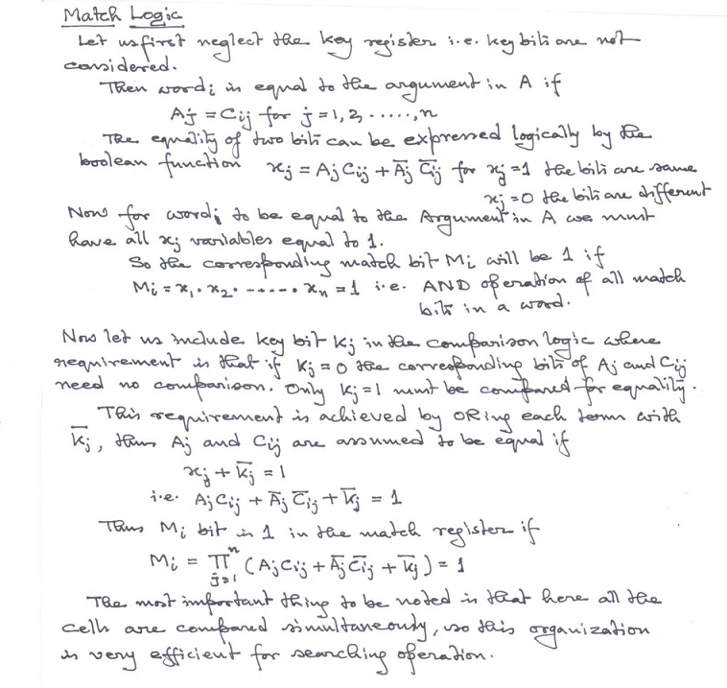

Slide 24
Read Operation
If more than one word match, all the matched words will have 1 in the corresponding bit position of the match register. It is then necessary to scan the bits of match register one at a time and the matched words are read in sequence by applying a read signal to each word line where corresponding Mi bit is 1.
In most applications associative memory stores a table with no two identical items under a given key. In such cases only one word may match. In such situation by connecting output Mi directly to the word read line in the same word position the contents of the match word may be received in the data buffer.

Slide 25

Write Operation
If entire memory is loaded with new information at once prior to a search operation then writing can be done by addressing each location in sequence. There we use a decoder with d lines such that m= to address m different words alike random access memory.
In case where unwanted words are deleted and new words are inserted one at a time there we use Tag Register. For every active word tag bit is set to 1, on deletion tag bit is simply set to 0. An unwanted word when deleted from memory, can be cleared to all 0’s if this value is used to specify an empty location.
Moreover only the active words i.e. with tag bit 1 will be compared during searching operation i.e. tag bit should also be considered in the match logic.
Thus,

Slide 26
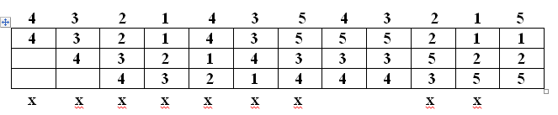
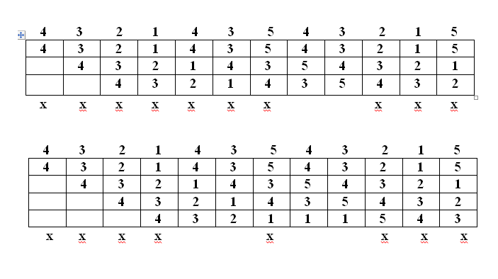
FIFO Replacement Technique
Page Trace
S = 3
F = 9
Failure ratio = 75%
Success ratio = 25%
Page Table
Size = 3
Page Faults
Page Trace
Page Table
Size = 4
Belady’s Anomally
S = 2
F = 10
Failure ratio = 83%
Success ratio = 17%
Page Faults
LRU Replacement Technique
Page Trace
S = 2
F = 10
Failure ratio = 83%
Success ratio = 17%
Page Table
Size = 3
Page Faults
Page Trace
Page Table
Size = 4
S = 4
F = 8
Failure ratio = 67%
Success ratio = 33%
Page Faults

Slide 27
VIRTUAL MEMORY
In memory hierarchy system, programs and data are first stored in auxiliary memory, portions of a program and/or data are brought into main memory as and when needed by the CPU. Virtual memory is a concept used in computer systems that permits the user to construct programs equal to the totality of auxiliary memory which is much larger than available main memory interfaced with the CPU.
Virtual memory is used to give programmers the illusion that they have a very large memory at their disposal, even though the computer actually has relatively small main memory.
Address Space and Memory Space
An address used by a program will be called a virtual address and the set of such addresses constitutes the address space.
An address in main memory is called a location or physical address. A set of such locations constitutes the memory space.
The address space is allowed to be much larger than the memory space in computers supporting virtual memory. The address field of the instruction has sufficient number of bits to specify all virtual addresses but CPU will get the information from physical memory which needs lesser number of bits for addressing. A table known as Page Map Table is used to map a longer virtual address to a smaller physical address.

Slide 28
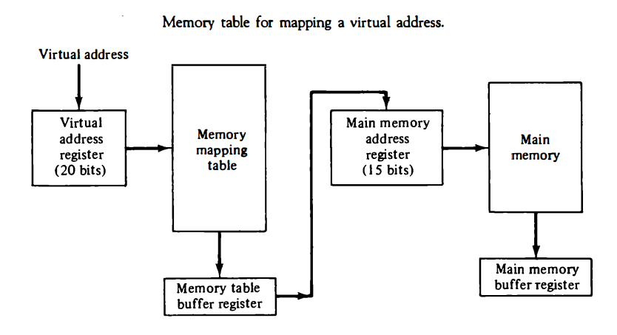
VIRTUAL MEMORY (Continued)
VAR Virtual memory register
MAR Main memory address register
VAR > PMT (Page map table) > MAR > Main Memory

Slide 29
VIRTUAL MEMORY (Continued)
To implement virtual memory system the CPU should have VAR in addition to MAR. The size of VAR is larger than MAR, so the system can address larger address space using VAR though the physical memory available for CPU is much lesser. (Since MAR is smaller than VAR)
To implement Virtual memory the secondary address space is divided into a number of equal size partitions called Secondary Blocks and primary address space is also divided into same size partitions called Primary Blocks so that any secondary block can exactly fit to any primary block.
Now to connect VAR and MAR we need PMT ( Page Map Table) which holds a number of Page Map Registers, one for each secondary block i.e. no. of Page map registers is equal to the no. of Secondary blocks. In fact a particular page map register corresponding to a particular secondary block, holds the primary block number currently having that particular secondary block provided the valid bit flag associated with that PMR is found set to 1. If the primary block is not available the valid bit remains set to 0.

Slide 30
PROCEDURE :
The address encountered by the CPU in user’s address space (virtual address space) is put in VAR. Next by portioning the content of VAR we get the secondary block no and the block offset. The secondary block no so obtained is used to index the page map table. If the valid bit of the indexed page map register is 1 (i.e. the secondary block is currently available in the primary memory) then the content of the indexed page map register is the primary block no. where the addressed secondary block is currently residing. Next the primary block no. so obtained from the corresponding page map register is concatenated with the block offset in the VAR, this forms the current primary memory address for the addressed secondary location.
If the valid bit of the indexed page map register is 0 (i.e. the addressed secondary block is currently not available in the primary memory) we will have to bring that secondary block in some available primary block. Now if we have free primary block/blocks the addressed secondary block is copied into any of the free primary block and the page map register corresponding to that secondary block is loaded with the primary block number where it has been copied and the valid bit of that page map register is set to 1. If no free primary block is available then any replacement algorithm is used to select a particular primary block, where the new secondary block will be copied and the page map table is updated accordingly (the valid bit of the page map register corresponding to the removed secondary block is set to 0 and the page map register corresponding to the newly brought secondary block is updated with the assigned primary block number as well as the valid bit is set to 1).

Slide 31
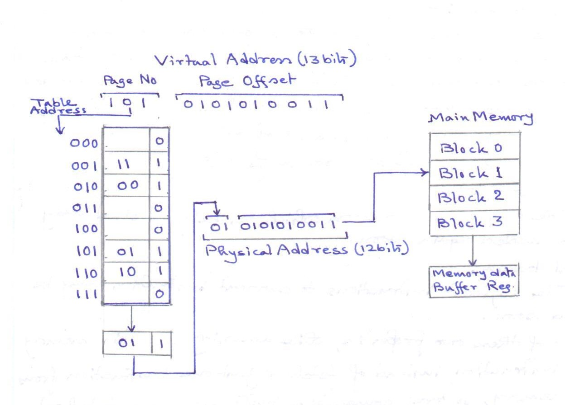
Virtual address to Physical address mapping

Slide 32
Now there are two major possibilities for placing the PMT. Either it can be placed in a portion of primary memory or separate high speed register stack can be used to store the PMT. In the first case the memory cycle time is doubled and the speed becomes half. In the next proposal we can gain speed but utilization factor of high speed registers is very poor because we need as many registers as the no. of secondary blocks but at any instant only a fraction of the registers, which is equal to the no. of primary blocks is in use ( the no. of primary blocks may be less than 1% of the total no. of secondary blocks).
So obvious suggestion would be to reduce the size of PMT to the no. of primary blocks. If we use associative memory to hold the PMT, the no. of locations in associative memory would be equal to the no. of primary blocks and each entry contains the address of the secondary block as well as the primary block where it is residing along with the valid bit.

Slide 33
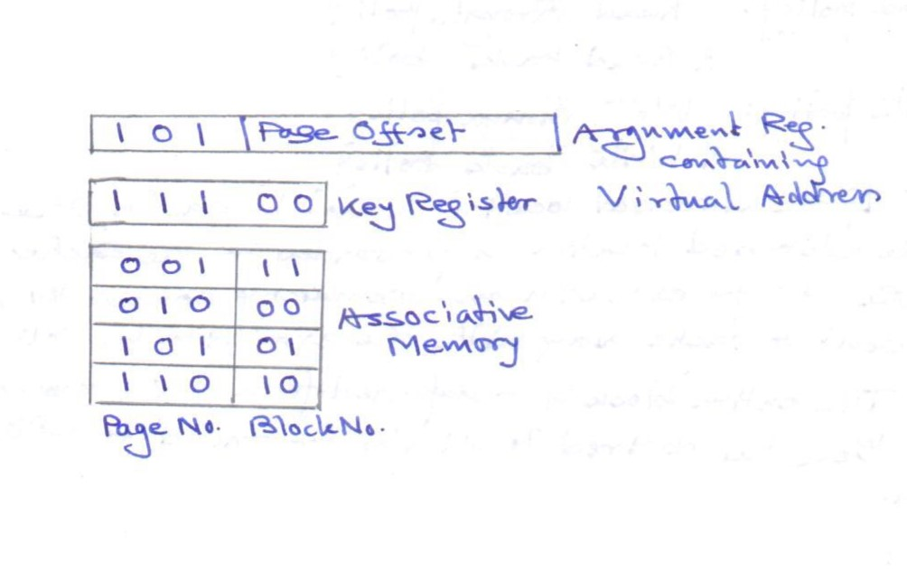
Concept of using Associative Memory to maintaining Page Map Table

